Slide 1
Use of Gitlab CI/CD, AWS CDK and ECS at National Geospatial Technical Operations Center (NGTOC)
DevOps Community of Practice
October 2019
Robert Djurasaj
USGS/NGTOC

Slide 2
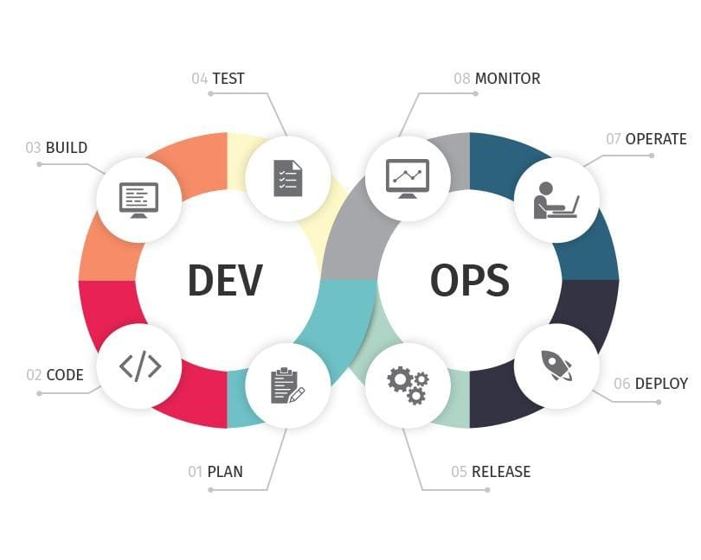
DevOps
Notes:
DevOps (development and operations) is an enterprise software development phrase used to mean a type of agile relationship between development and IT operations. The goal of DevOps is to change and improve the relationship by advocating better communication and collaboration between these two business units.
DevOps works by extending the lean-agile mindset to operations with a focus on automation so as to drive faster deployment.

Slide 3
Overview
Gitlab (GitOps)
Infrastructure as Code (IaC) runner
Service catalog
Group runners
AWS CDK
IaC centric approach
https://aws.amazon.com/cdk/
https://github.com/aws-samples/aws-cdk-examples
Elastic Container Service (ECS)
Fargate

Slide 4

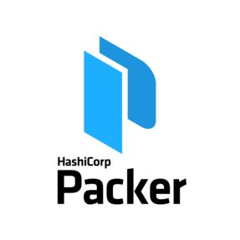
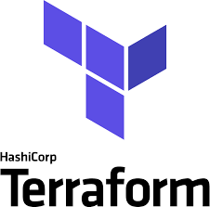

Selection
Automation mindset
CI/CD centric approach
Minimize human intervention
Infrastructure as Code (IaC)
Terraform and/or AWS-CDK
Packer
Pulumi
Immutable infrastructure
Configuration as Code (CaC)

Slide 5
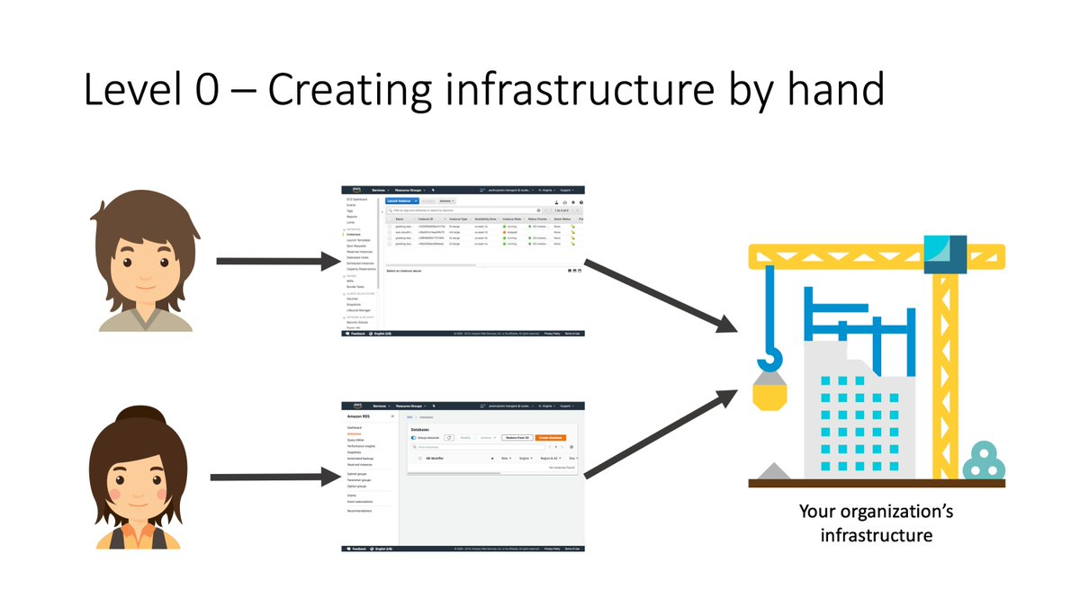
IaC Evolution...
Attribution: @nathanpeck
Icons: Flaticon.com

Slide 6
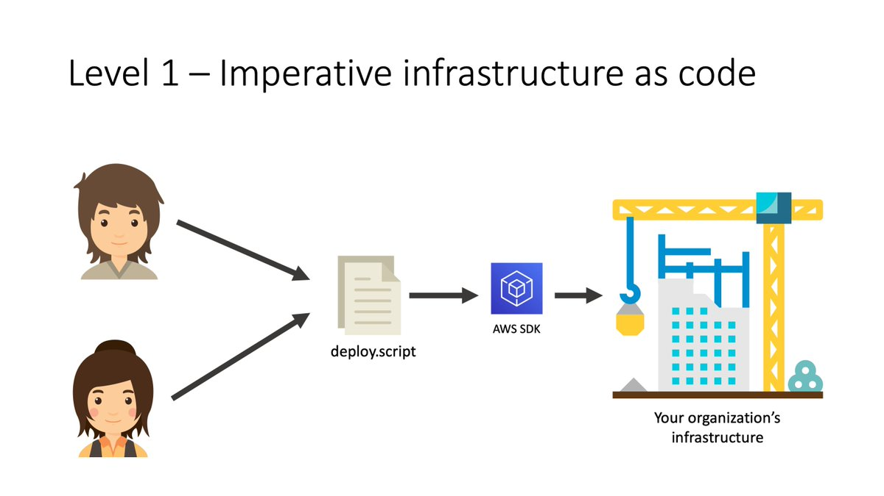
IaC Evolution...
Attribution: @nathanpeck
Icons: Flaticon.com

Slide 7
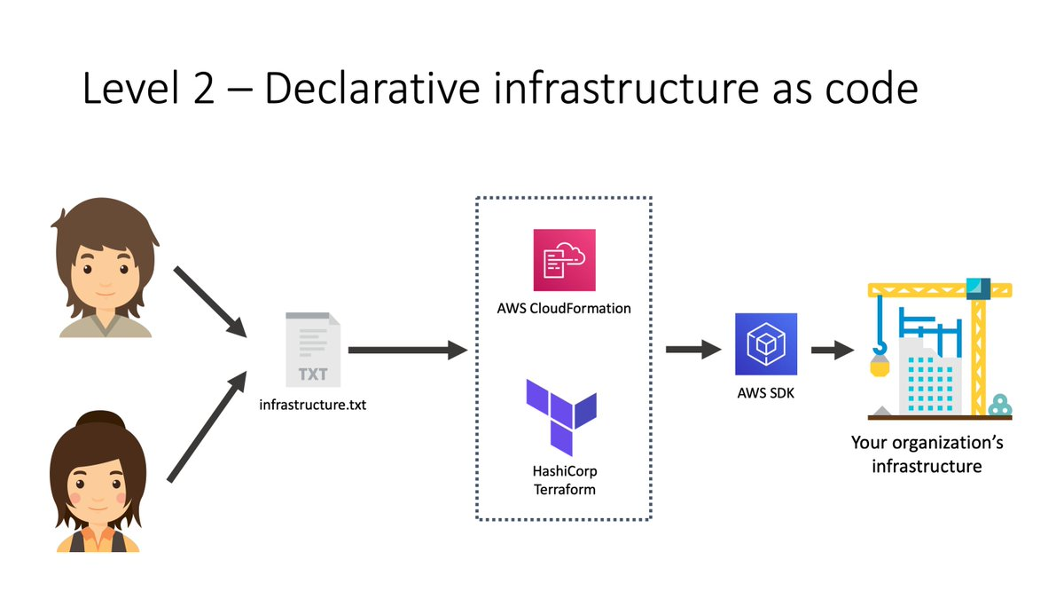
IaC Evolution...
Attribution: @nathanpeck
Icons: Flaticon.com

Slide 8
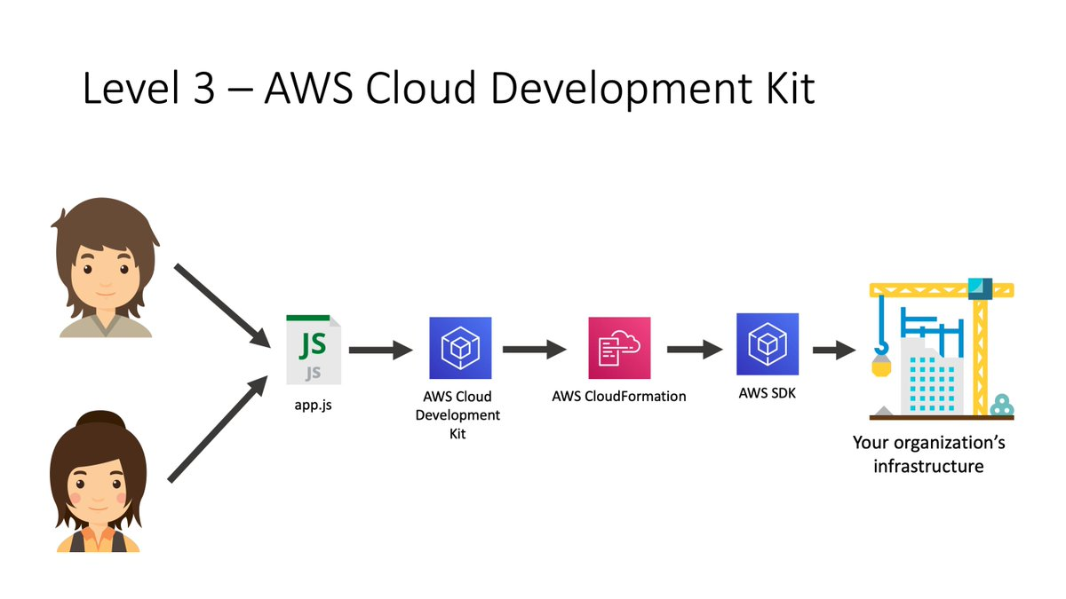
IaC Evolution...
Attribution: @nathanpeck
Icons: Flaticon.com

Slide 9
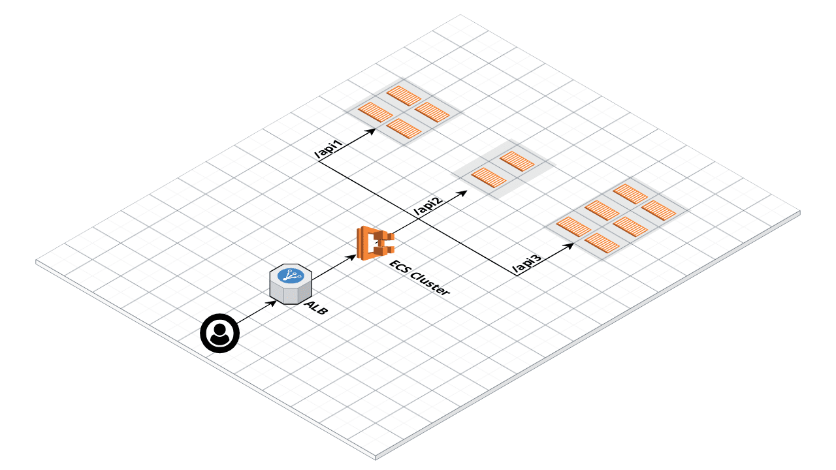
AWS infrastructure at a glance

Slide 10
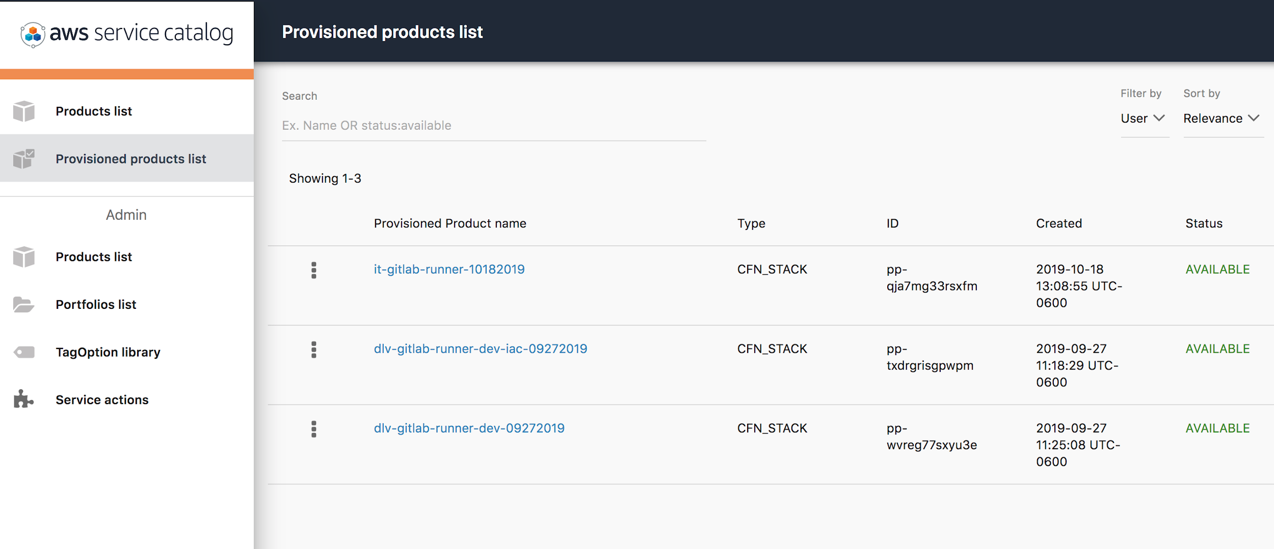
Gitlab Runner Provisioning

Slide 11
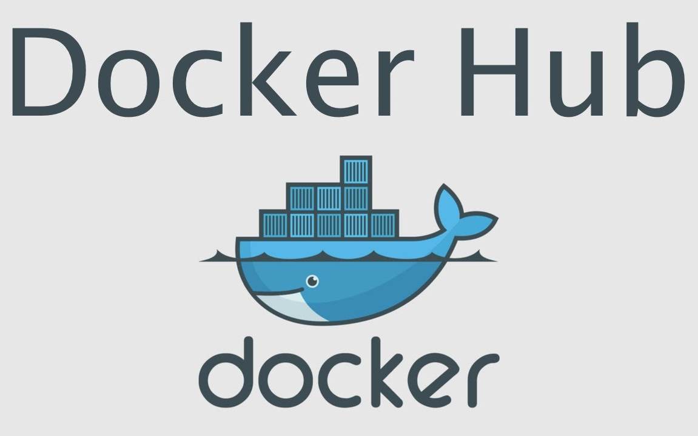

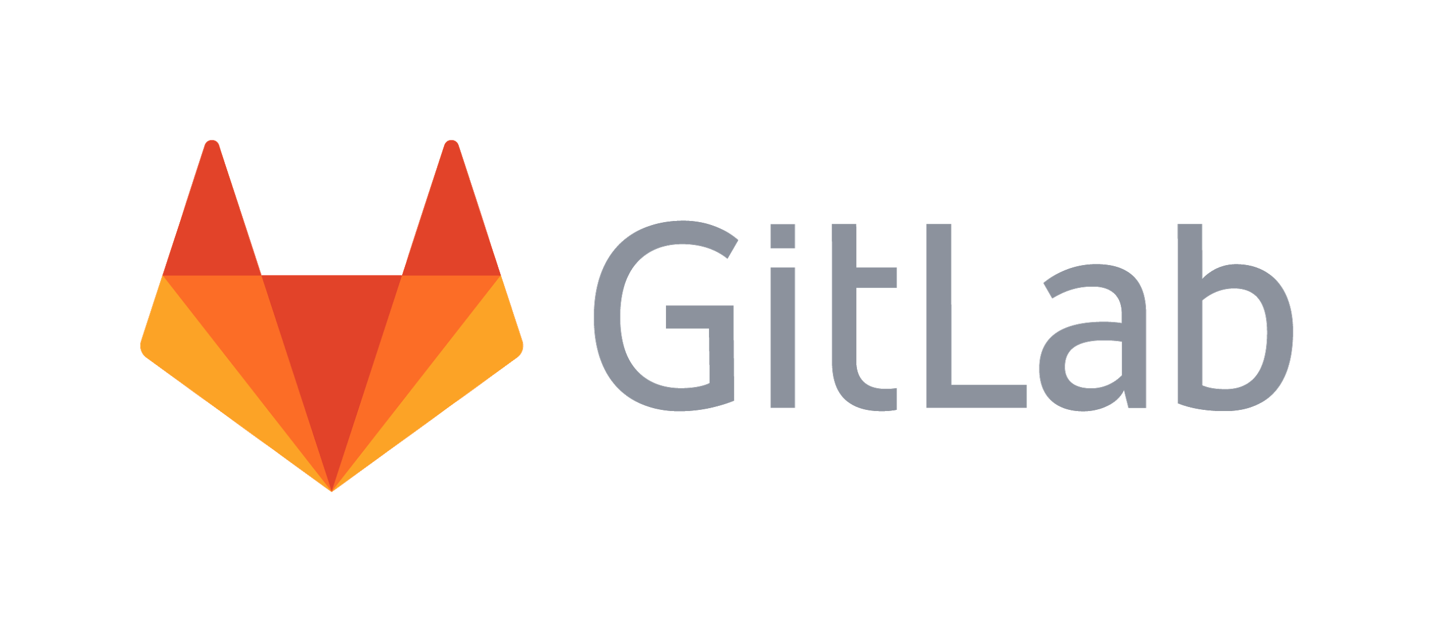

NGTOC
Gitlab IaC Runner
AWS CDK
CHS
Gitlab
Container
Registry
AWS
ECS

Slide 12
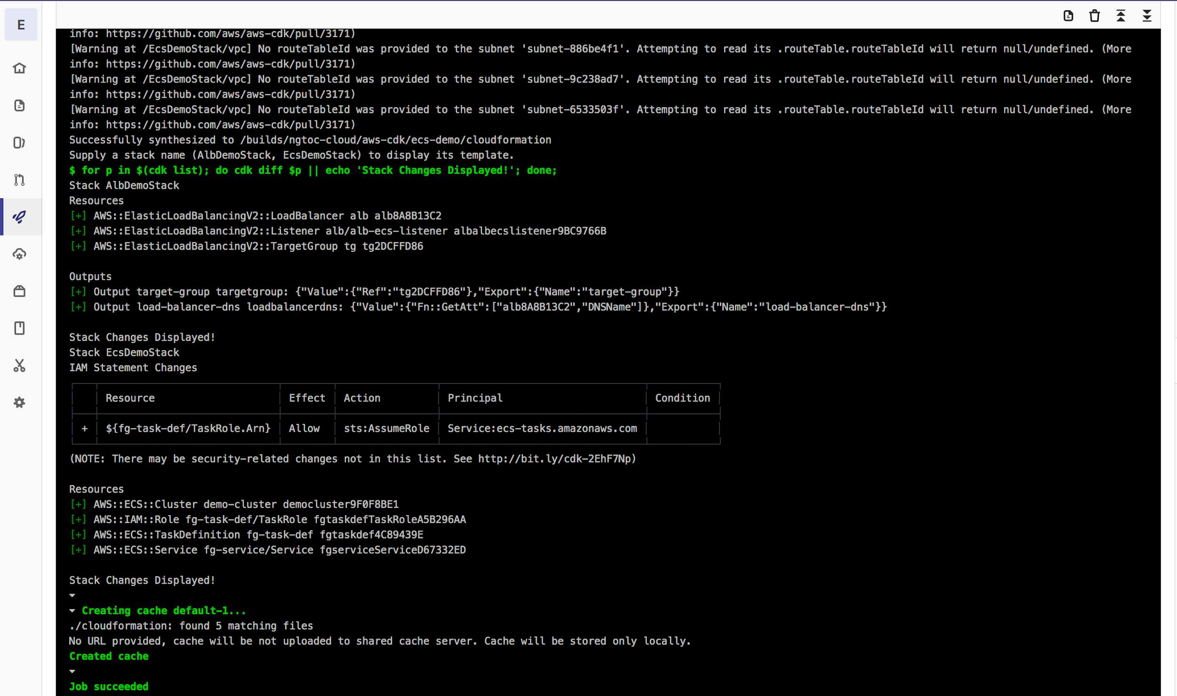
Gitlab CI/CD

Slide 13
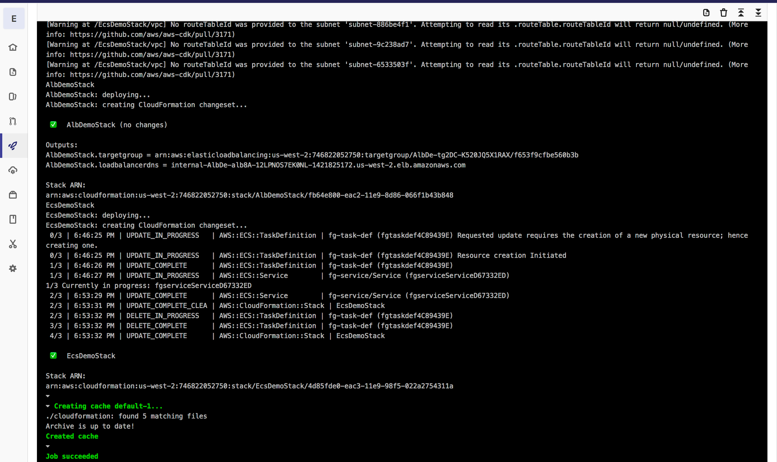
Gitlab CI/CD (cont.)

Slide 14
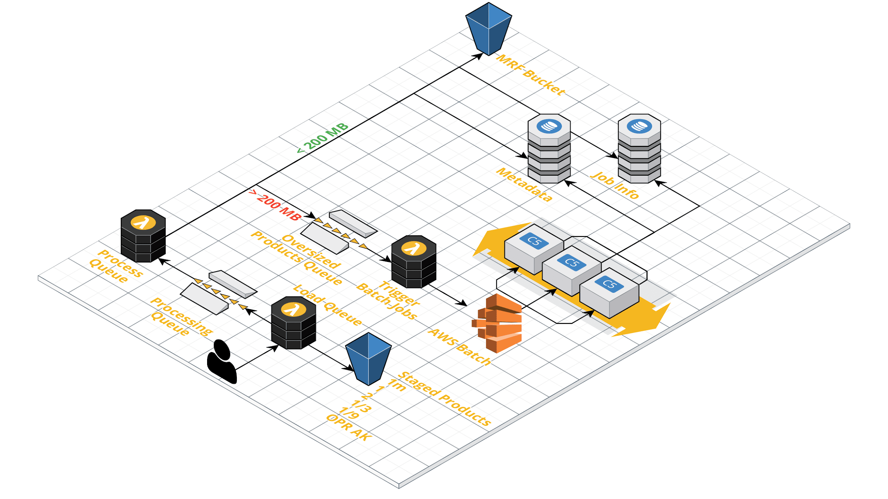
Advanced AWS CDK Solutions -
Meta Raster Format (MRF) Processing

Slide 15
Contact
Robert Djurasaj
Cloud Architect (detail)
Delivery Project Manager
National Geospatial Technical Operations Center (NGTOC)
U.S. Geological Survey
Denver, Colorado
office: 303-202-4538
email: rdjurasaj@usgs.gov
Notes:
image from: https://cloud.google.com/blog/products/gcp/the-five-phases-of-migrating-to-google-cloud-platform

